Slide 1
P1 Assignment: Dimensional Modeling
ISM6208.020U23
Dalton Anderson & Kevin Hitt | June 2023

Slide 2
Part A: Dimensional Design for Stock Market Data

Slide 3
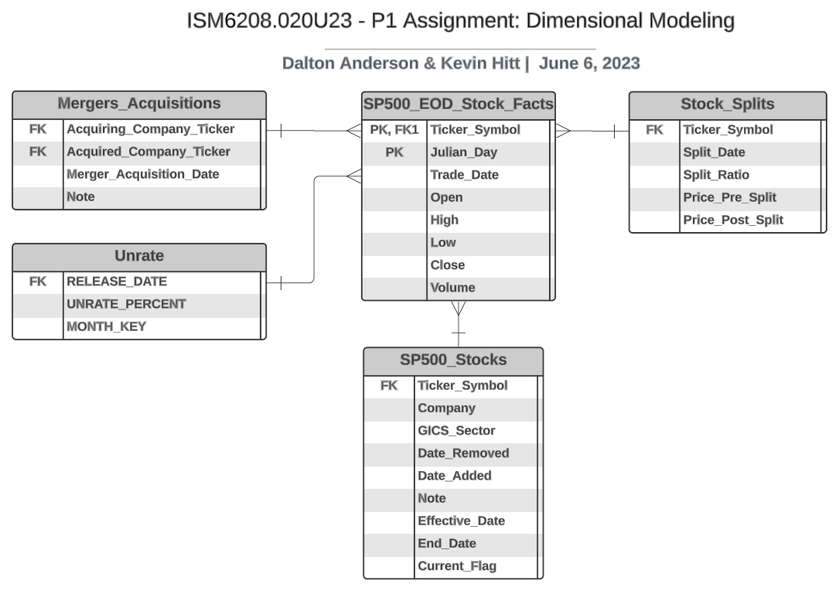
Part A – Entity Relationship Diagram (ERD)
*Note: Table capitalization
and prepending of “PEARL_”
group label may vary between
ERD, descriptions, and queries

Slide 4
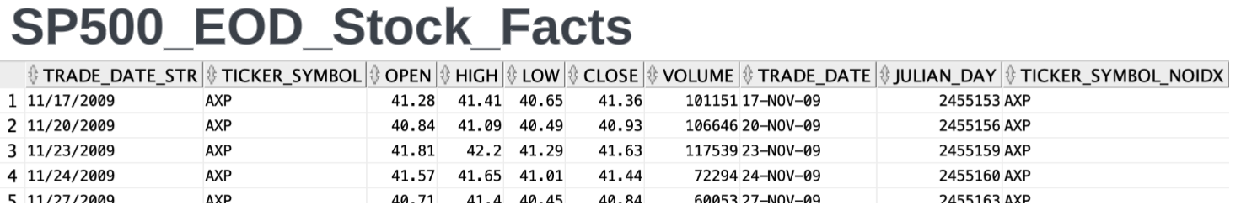
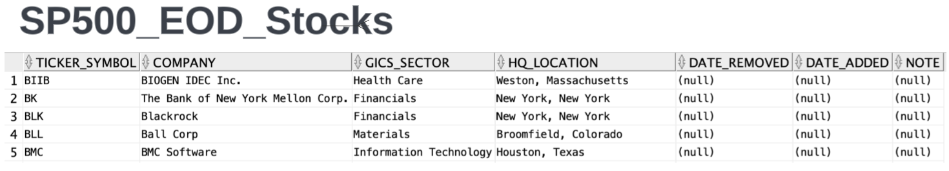
Part A – Tables Preview (1)

Slide 5
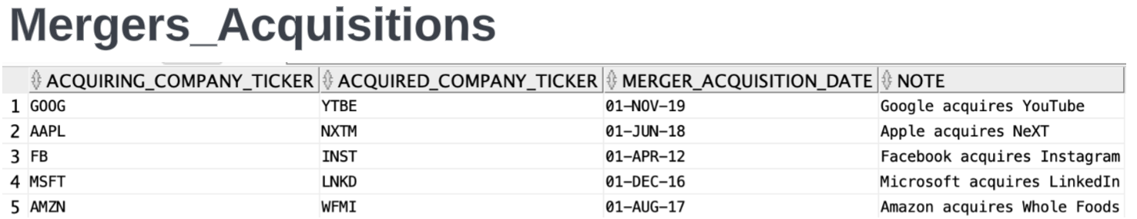
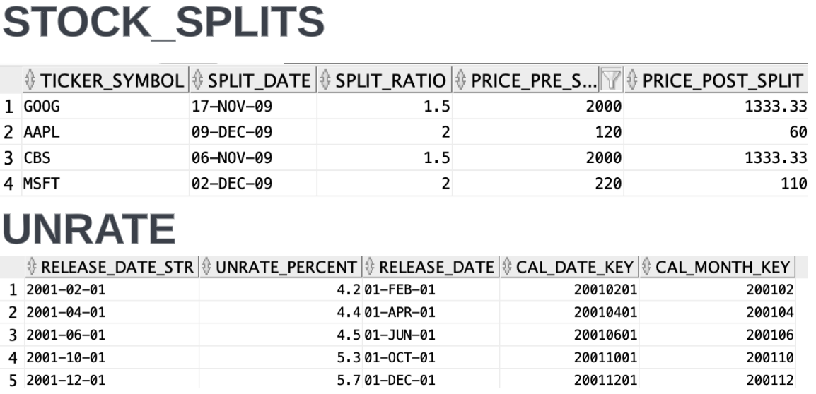
Part A – Tables Preview (2)

Slide 6
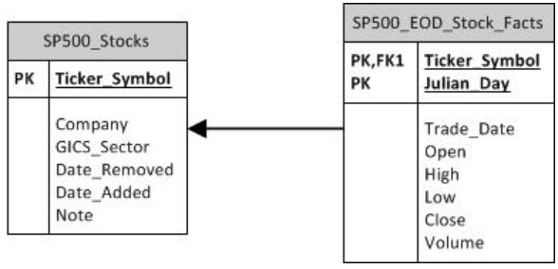
Part A – Design Notes
How would you extend the design to handle complexities like stock splits (or reverse stock splits), mergers and acquisitions, or changes in business itself such as new sectors?
Free to extend the project by adding any additional data.
Stock_Splits table created to track when splits occur and how they affected the stock price
Mergers_Acquisitions table created to track consolidation of companies.
Effective_Date, End_Date, Current_Flag added to SP500_Stocks table as SCD to preserve the history sectors the companies have been in over time.
FRED_UNRATE table added to design (67 years monthly unemployment rate data)
Figure 1: Base design modified

Slide 7
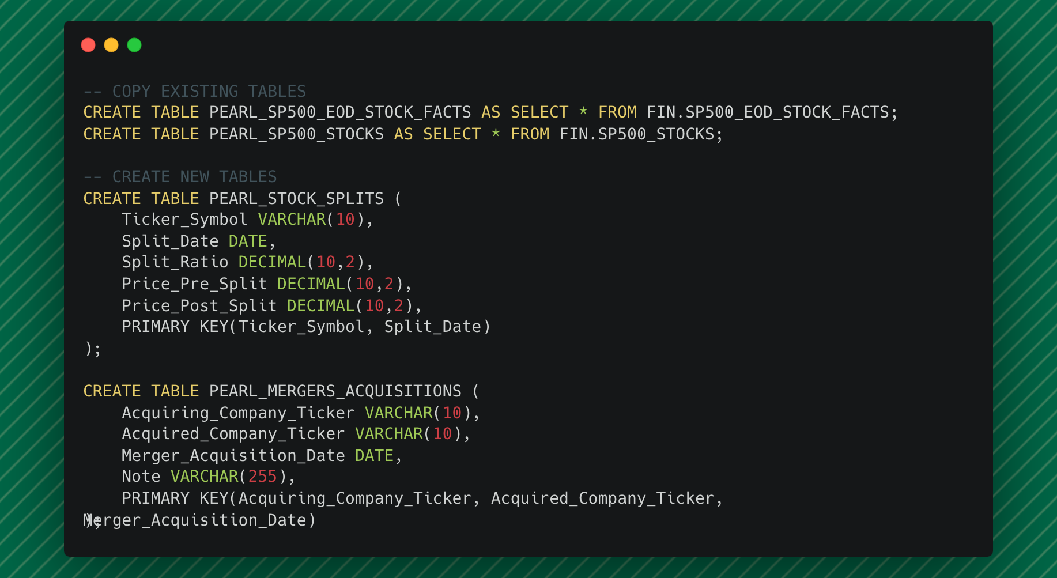

Slide 8
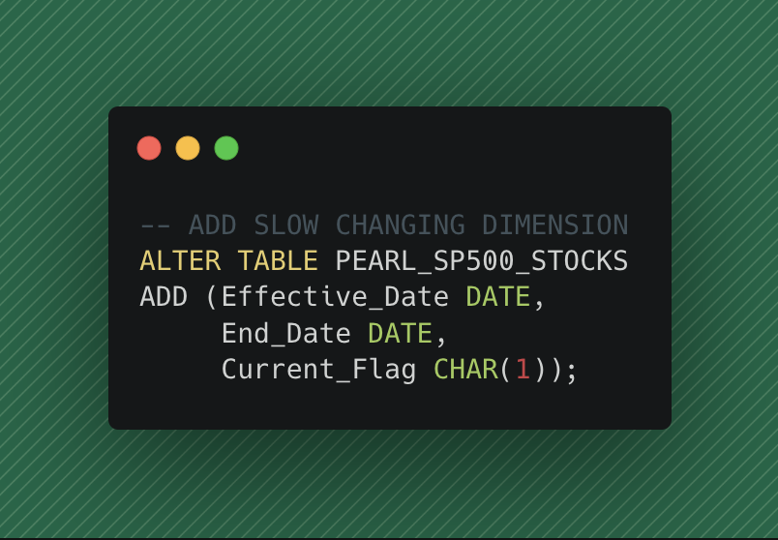

Slide 9
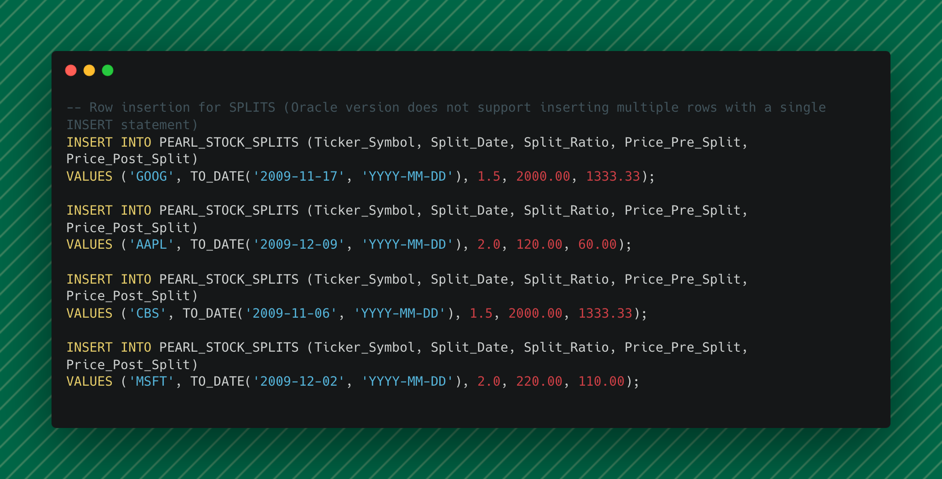

Slide 10
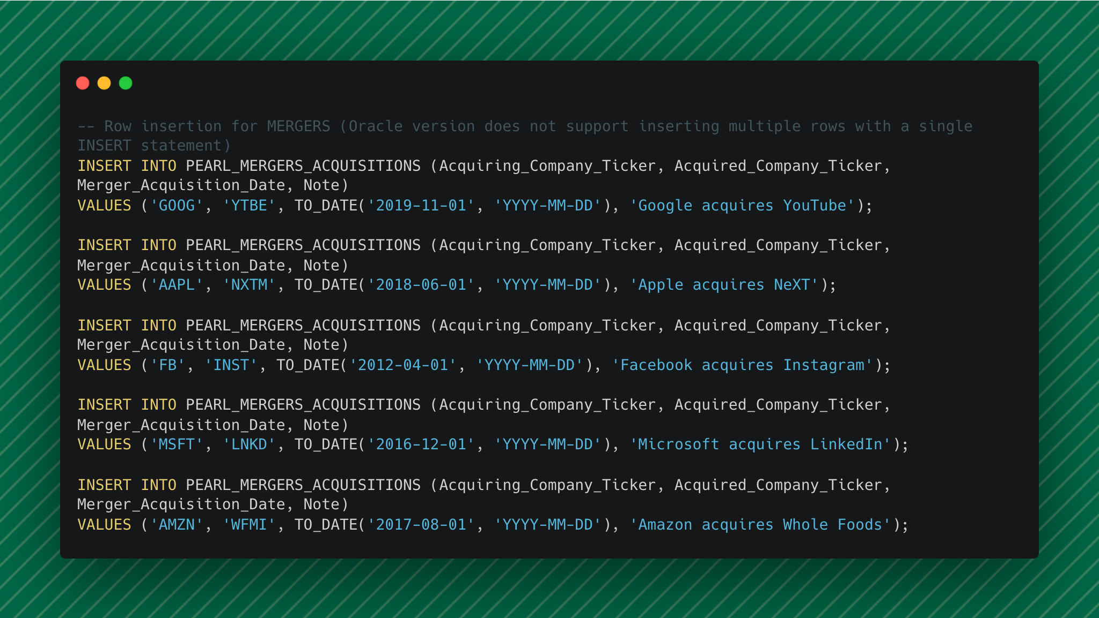

Slide 11
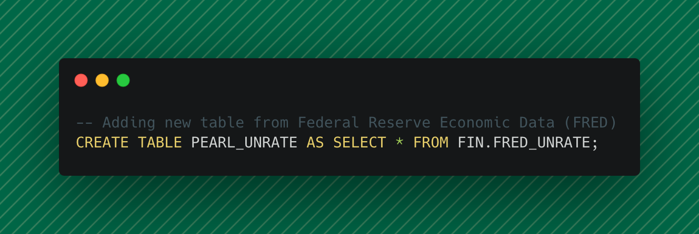

Slide 12
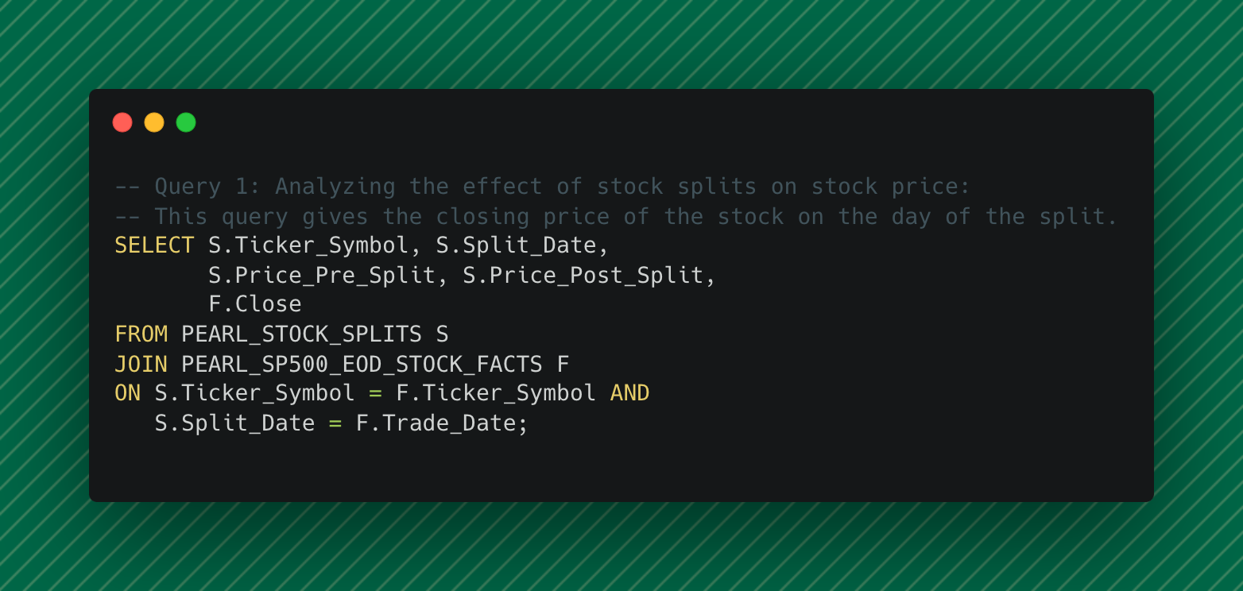
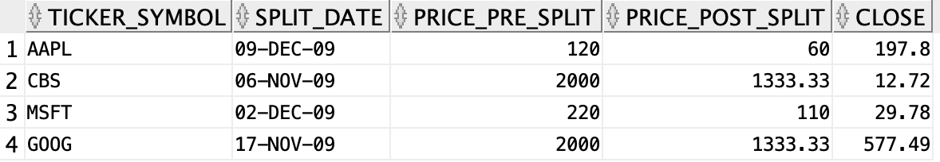

Slide 13
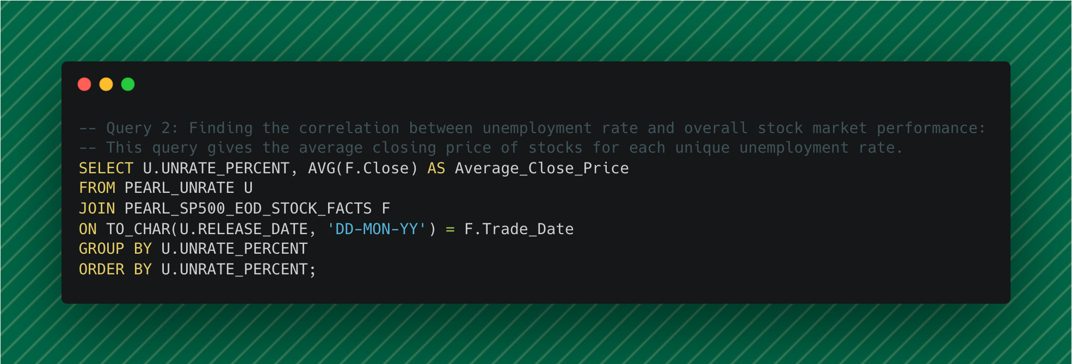
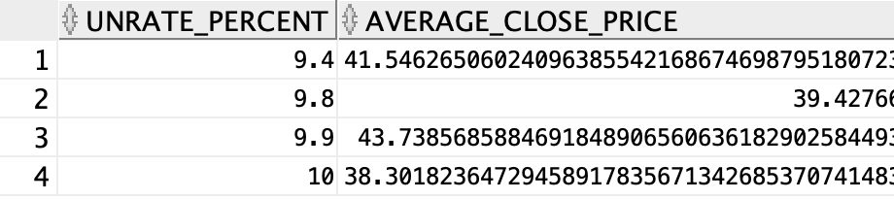

Slide 14
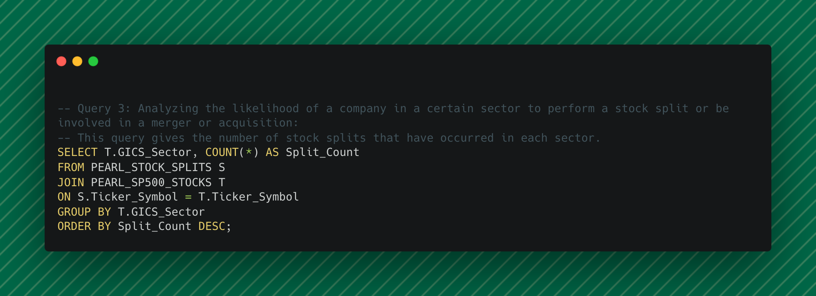
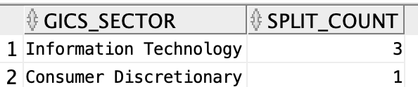

Slide 15
Part B: Dimensional Model for Data of Your Choice

Slide 16
Part B – Consumer Financial Protection Bureau Mortgage Delinquency Rates from 2008 to 2022-09

Slide 17
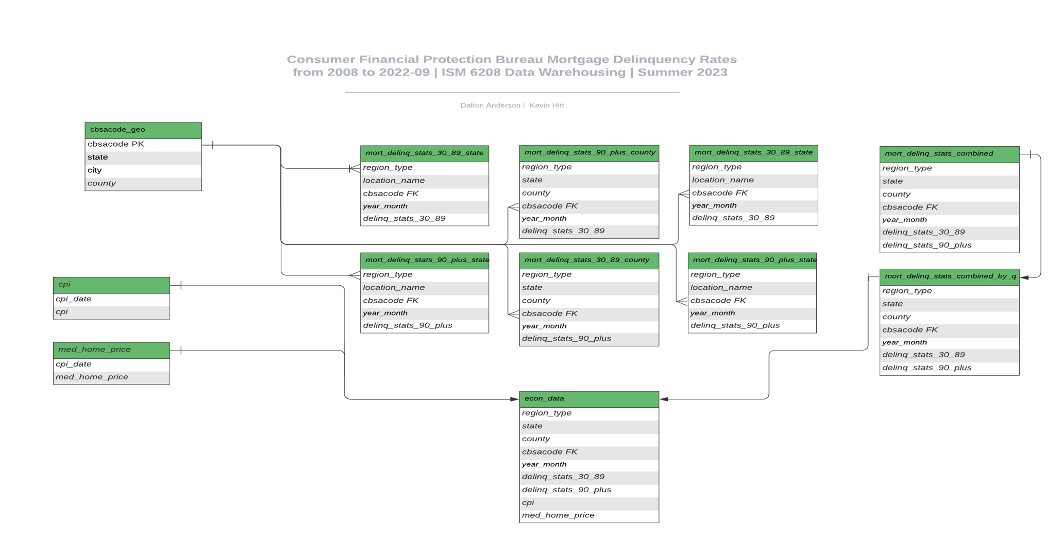
Part B – Entity Relationship Diagram (ERD) (1)

Slide 18
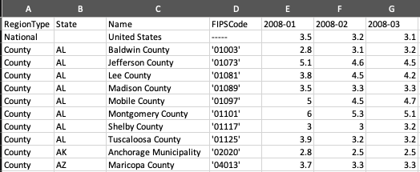
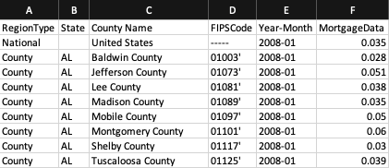
Part B – Tables Preview ETL (2)
CountyMortgagesPercent-30-89Day
*Note: The majority of time in Part B was dedicated to the ETL process (Extract, Transform, Load). This process entailed constructing a macro for each state, county, and metropolitan area file to change the date format from column-based to row-based.
County-30-89 Cleaned

Slide 19
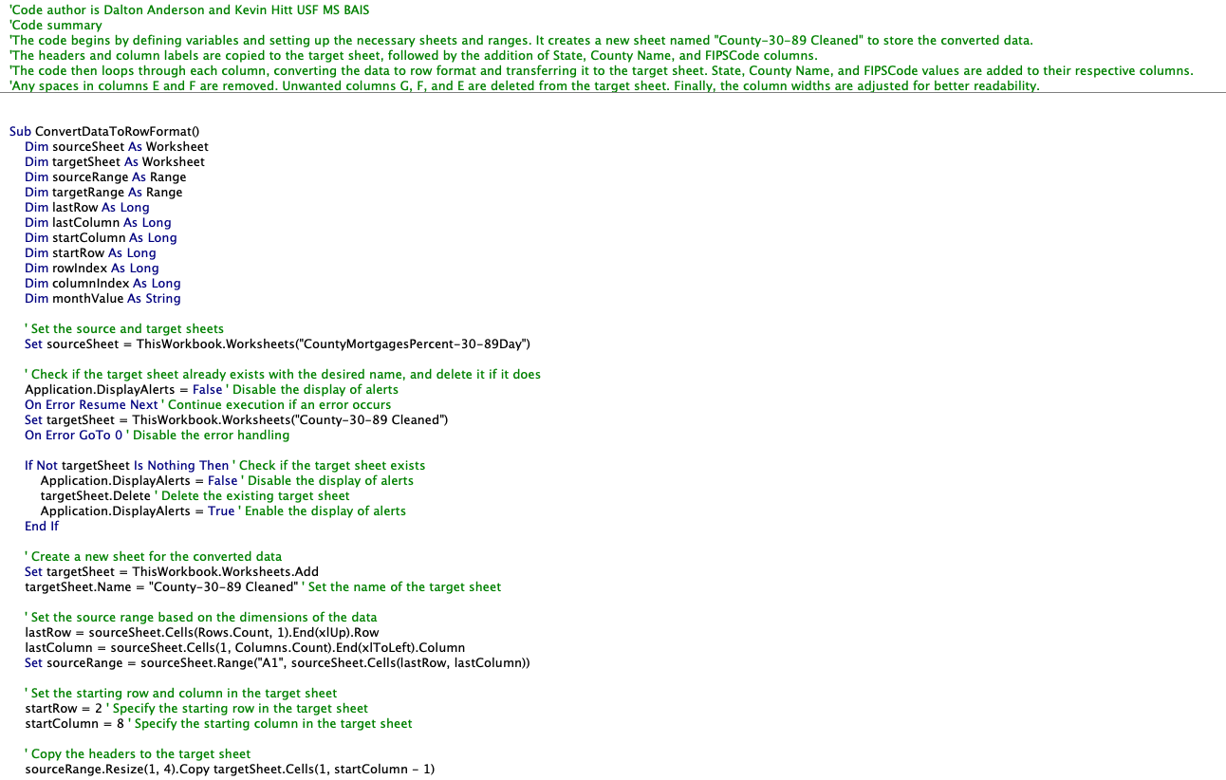
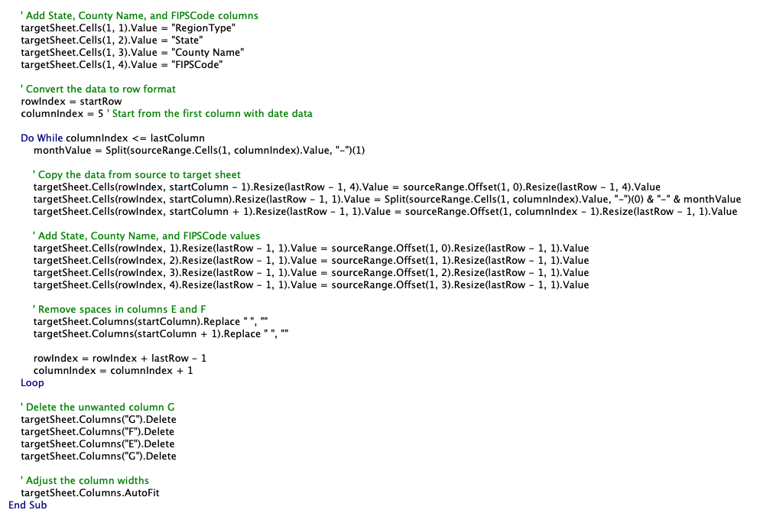
Part B – Tables Preview ETL Macro (3)

Slide 20
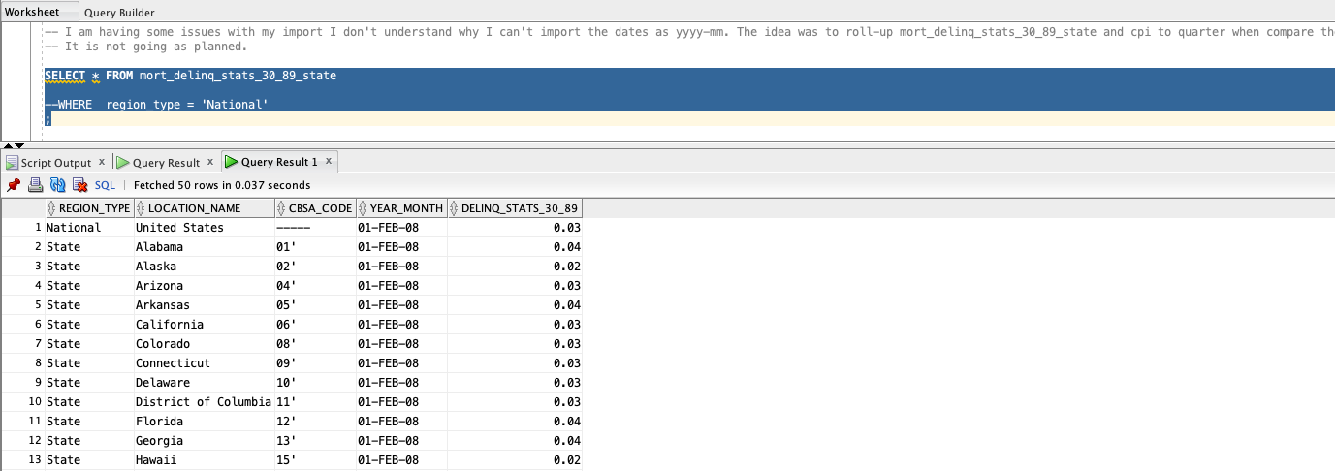
Part B – Tables Preview mort_delinq_stats_30_89_state (4)

Slide 21
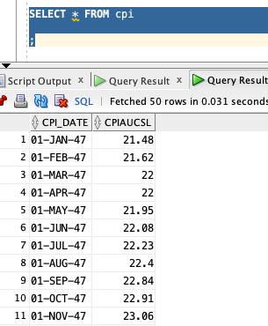
Part B – Tables Preview CPI (5)

Slide 22
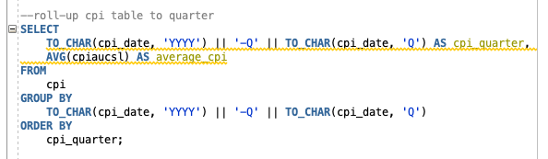
Part B – SQL Preview CPI Roll-up

Slide 23
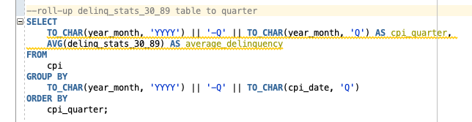
Part B – SQL Preview mort_delinq_stats_30_89_state Roll-up

Slide 24
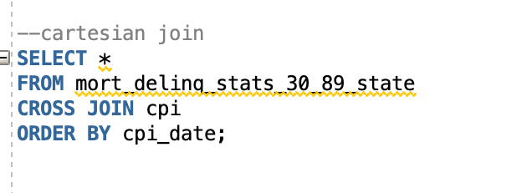
Part B – SQL Preview Cartesian join

Slide 25
Thank you!
GITHUB LINK
anderson669@usf.edu
kevinhitt@usf.edu

